Slide 1
Jewish Culture
Jesus was a Jew, but only on his mother’s side.
- Archie Bunker

Slide 2
How it all began…
Roots are traced back as far as 2000 B.C.E.
Modern day Israel and Palestine is believed to be the location of origin.
At the time was known as Canaan.
Approximately 14,000,000 followers.
Sacred text is called the Torah.
https://www.youtube.com/results?search_query=mel+brooks+10+commandments

Slide 3
Terms you may know…
Kashrut – laws of eating.
Shabbat – Sabbath or holy day, Saturday.
Kosher – foods permitted by the Torah for various reasons.
Bat Mitzvah – adulthood for girls at age 12.
Bar Mitzvah – adulthood for boys also age 12.
Brit Millah – circumcision on the 8th day after birth.
Kiddish – celebration on the Sabbath for girls following birth.
Chuppah – ceremony at the beginning of the wedding where a glass is broken

Slide 4
Holidays and Events
Purim
Passover
Second Passover
Lag BaOmer
Shavuot
The Three Weeks
The 15th of Av
Rosh Hashanah
Yom Kippur
Sukkot
Chanukah
Tu B’Shevat
Shomer Shabbat

Slide 5
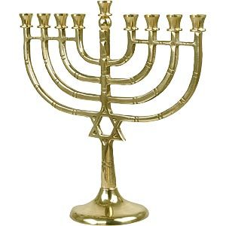
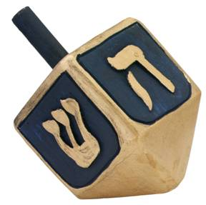
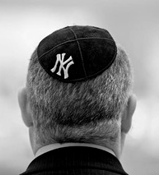
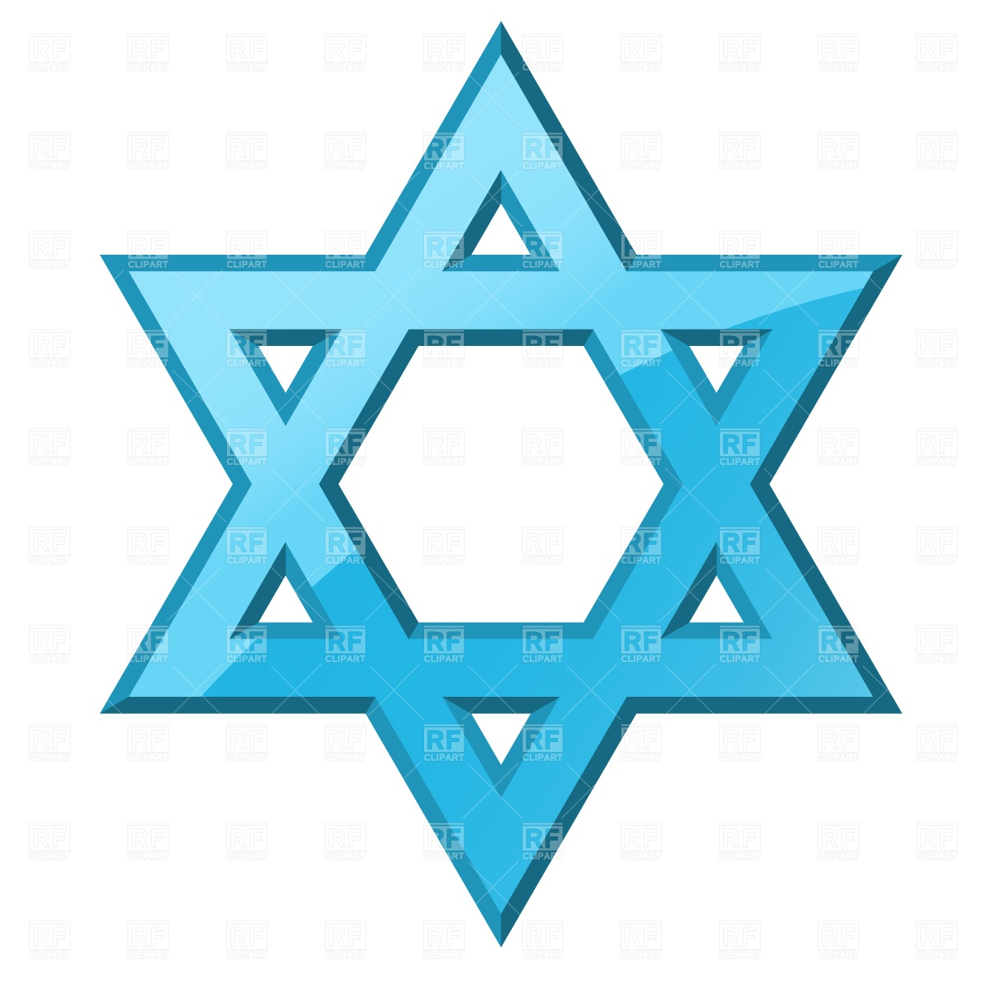
Symbols and Artifacts

Slide 6
Svetlana and John tell us how it is.
Written and Narrated by Svetlana
Produced my Johm McDermott
The song playing is “Hava Nagila”.
https://www.youtube.com/watch?v=cox4oTYdlQ4

Slide 7
References
www.orthodox-jews.com
Fishman, S. B. Jewish Life and American Culture. (2000). State University of New York Press, Albany. Taken from. https://books.google.com/books?id=LNKKI23R1vEC&pg=PA172&lpg=PA172&dq=jewish+culture+frustrations&source=bl&ots=yORWGLSgUX&sig=PYdHzQdu_4ClfbFyG0Ryljw0lFY&hl=en&sa=X&ei=xW7vVODzH5C1ogSatoHIAw&ved=0CB4Q6AEwAA#v=onepage&q=jewish%20culture%20frustrations&f=false
Jewish terms. Taken from. http://www.jewfaq.org/glossary.htm
Chabad Lubavitch of Utah http://www.jewishutah.com/library/article_cdo/aid/45132/jewish/What-Makes-a-Jew-Jewish.htm
9th South Delicatessen http://www.9thsouthdeli.com/deli-menus/
Feldman’s Deli http://www.feldmansdeli.com/
Patheos Library. Taken from. http://www.patheos.com/Library/Judaism.html

